Slide 1
Microsoft Azure Foundation Training
Venkateswarlu A

Slide 2
Agenda
Why Azure Cloud?
Microsoft Azure Service Models - IaaS/PaaS/SaaS
Azure cloud Compute – Virtual Machine
Azure Less Worries
Microsoft Azure Services
Azure Cloud Computing Terminology
Azure Storage
Azure Virtual Network (Vnet)
RBAC Role based access control
Migrating Applications to Azure
Use case study

Slide 3
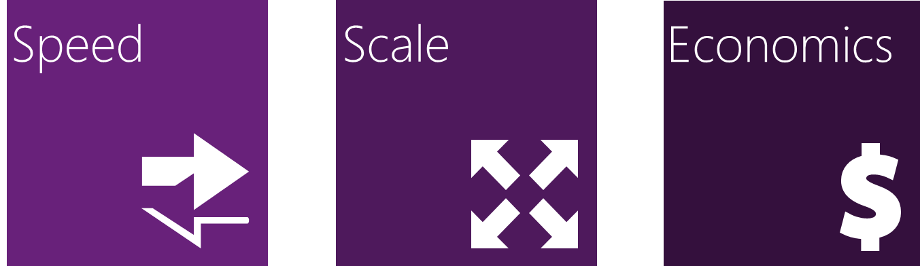
Why Azure Cloud?
Azure as a platform is a collection of services that you can use to host your applications and workloads in a cloud.
Azure is enabling compelling new business models for Microsoft partners
Reduced capital expense, Fast time to market, Elastic scale.
Global availability , Consumption-based billing.
Rapidly setup environments to drive business priorities
Scale to meet peak demands
Increase daily activities, efficiency and reduced cost.

Slide 4
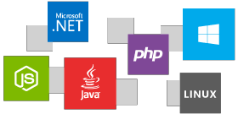
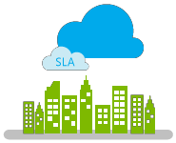


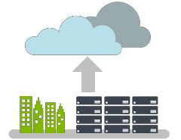

Why Azure Cloud? (Cont..)
Open and flexible cloud service platform
Run your apps anywhere
Hybrid Cloud
Enterprise Grade
Scale as you need,
pay as you go
Rely on a trusted cloud service
Make smarter decisions
Protect your data

Slide 5
Azure Cloud Compute
Cloud Computing - A transforming Technology
Infinite shared resources & services
Infrastructure is not a limiting factor
No need to equip for peak-load requirements
Elasticity on demand
Anytime, anywhere
Efficient scalability and high availability
Suitable pricing models
Pay for what you use
Automation, Monitoring, Deployment
Reduce cost, shift risk, shorten time-to-market, focus on business functionality

Slide 6
Azure Less Worries
Focus on functionality development
Let others take care of:
Resource management
Security
Environments (staging, production)
High availability, scalability, load balancing
Fault tolerance
OS - installation, licensing, updates, patches
Network
Maintenance

Slide 7




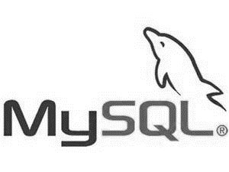
























Microsoft Azure Services
Visual Studio Online
Application Insights
Scheduler
Automation
Operational Insights
Key Vault
…
Developer
Services
Management
Marketplace
HDInsight
Machine Learning
Stream Analytics
Data Factory
Event Hubs
BizTalk Services
Service Bus
Backup
Site Recovery
Media Services
Analytics
& IoT
Hybrid
Integration
Media & CDN
App
Service
API Management
Notification Hubs
Mobile Engagement
Azure Active Directory
Multi-Factor Authent
CDN
Web
& Mobile
Identity
& Access
Web App
Mobile App
API App
Logic App
Virtual Machines
Cloud Services
Batch
Service Fabric
RemoteApp
Virtual Network
ExpressRoute
Traffic Manager
DNS
Application Gateway
Compute
Networking
Storage
SQL Database
Search
DocumentDB
Redis Cache
StorSimple
Data Lake
Data Warehouse
Data
& Storage
Blobs
Tables
Queues
Files
Notes:
Microsoft Azure platform is a collection of services.
Azure Websites is a PaaS offering that allows you quickly and easily deploy and scale up a web application.

Slide 8
Microsoft Azure Service Models

Slide 9




Azure Cloud Computing Terminology
Blade - when you view setting of service instance or take an action , the details are displayed in vertical box known as Blade.
Journey – Collection of sequential blade,
Dashboard- is the first screen you see when you log on to portal or collection of pinned tiles.
Resource group – represents a new way of logically grouping your service instances. Service instances are known as resources and a collection of resources can exists in Resource Group. Has common life cycle.
Service Plan --

Slide 10










Managing of Azure Service Models

Slide 11
IaaS- Infrastructure as a Service
Infrastructure –as-a-Service offering that allows you to deploy a compute instances in a minutes to be used for Windows or Linux Workloads. Azure provides networking, backup services and virtualization services.
Features
Use images built by the product teams to deploy workloads such as SQL server , Share point or Apache
Attach, format and configure multiple disks for a VM
Remotely connect a Windows or Linux VM
Select different VM sizes ( A0-A9) - CPU ,IOPS and Memory referred as a VM size
Select a basic or standard tier

Slide 12
PaaS- Platform as a Service
Cloud service is Platform –as-a-Service offering that allows you to focus on your application code while Azure platform takes care of scaling up your application and making it highly available
Features
Associate VM with cloud services
Scale up an instance and configuring load balance
Deploy an existing cloud service package
Web Apps
- develop and deploy using Microsoft visual Studio ( .Net, JAVA, PHP, Node.js and python)

Slide 13
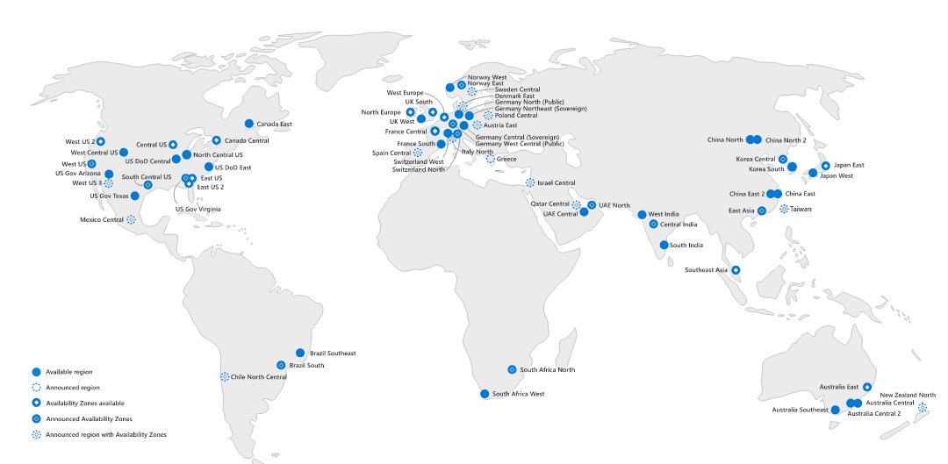
Microsoft Azure – 54 Regions Worldwide
140 available in 140 countries
Notes:
A region is a set of datacenters deployed within a latency-defined perimeter and connected through a dedicated regional low-latency network.

Slide 14
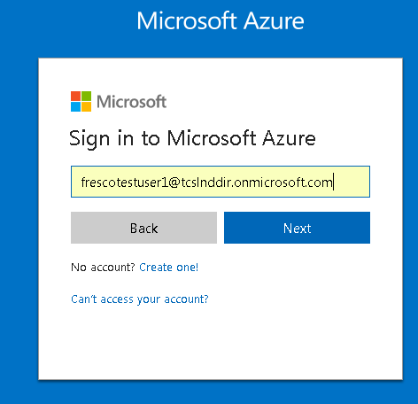
Azure Portal Demo
Login to : https://portal.azure.com
Portal walk through.
Understanding jargons ..
Creating VM ,
Web Apps
- develop and deploy using Microsoft visual Studio ( .Net, JAVA, PHP, Node.js and python)

Slide 15
Azure Compute - Virtual Machines
Provides Compute on demand for your application workloads .You Bring it, we run it. Scalable, on demand infrastructure for your Apps,
Where IaaS fits
Apps with public web front ends variable traffic sitting in a perimeter network.
Existing custom apps, specially servers with batch processing patterns
No App change same VHD format
Compute Tiers
Basic
Standard
Non-Production Workloads
Dev/Test Servers
No Load Balancing or Auto Scale
Not Memory Intensive Economic Option
No SSD or Premium Storage
Recommended for Production Workloads
All Server Types
Option for SSD and Premium Storage

Slide 16
Virtual Machine Storage Architecture
Virtual Machine Storage Architecture
Azure Virtual Machine
C:\
OS Disk
E:\, F:\, etc.
Data Disks
D:\
Temporary Disk
Disk Cache
Azure Blob

Slide 17
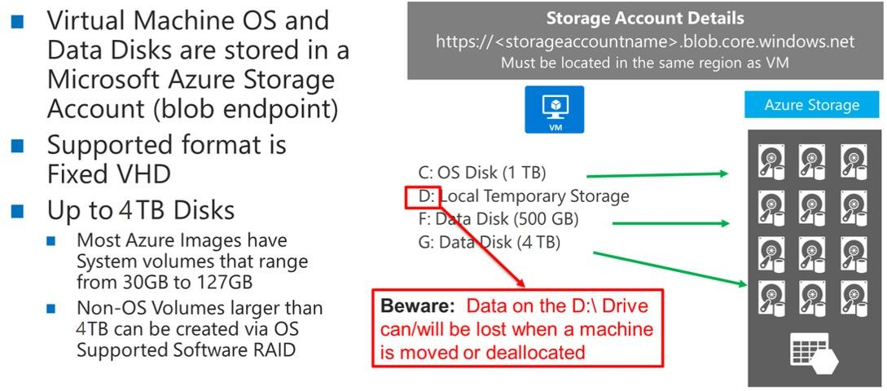
Virtual Machine Disks

Slide 18

Availability Sets
An Availability Sets to group 2 or 3 VM’s in a manner such that provides redundancy for application and is required for SLA
Update Domain – upgraded together .
Fault Domain - Physical point of failure.
Virtual Machine
Virtual Machine
SQL Server
Primary
SQL Server
Secondary
Availability set SLA 99.95

Slide 19
Autoscale for IaaS
The Autoscale Service for IaaS supports auto scaling VMs which are in the same Availability Set only
Configurable only via Azure Portal, APIs or via Management Client
Supported for Standard VM sizes only
Customer still pays for storage even when VM is stopped by autoscale service

Slide 20
Microsoft Azure Storage

Slide 21
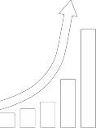








Slide 22
Public Cloud Storage with Azure
Supports For Hybrid Cloud
Storage
Data Protection
Disaster Recovery
Blobs, Disks, Tables, Files, & Queues
Data transfer options
Strong consistency
Redundant storage
Access control
Simplified compliance
Azure Site Recovery
Read Access Geo- Redundant Storage
Cloud-based business
continuity solutions

Slide 23
Azure Storage Services
Bolbs
Tables
Queues
Highly Scalable, REST based cloud object store
Block Blobs – Sequential file IO
Page Blobs – Random write Pattern Data
Append Bolbs -
Massive Auto Scaling No SQL Store.
Dynamic scaling based on load .
Scale to PB of table data.
Fast Key/Value Look Up
Reliable queues at scale for cloud services
Message visibility time outs.
Disks
Files
Persistent disks for Azure IaaS VM’s
Built on Page Bolbs
Premium storage based disks: SSD based, high IOPS , Low latency
Managed disks
Fully managed Files shares in the cloud SMB protocal.
Map to File share
Lift and Shift Legacy Apps

Slide 24
Azure Queue Storage Concepts
Queue provide a method of storing messages that can be accessed from any number of clients
Queue methods Insert , De-Queue , Peek and also view last cached message count.
Windows Azure Service Bus is a managed message infrastructure.
http://<account>.queue.core.windows.net/<queue>
Migrating Applications to Azure
Account
Queue
Messages
msg1
images
msg2
akmet
videos
ms3

Slide 25
Azure Blob Storage Concepts
All storage Blobs are associated with http URL. Stores Unstructured text , binary data or files , Exposed publicly. Used to store files like VHD ,Videos, images and log text files.
REST API methods to access bolbs : GET BOLB , POST , PUT , DELETE .
SAS token enabled .
CDN
Migrating Applications to Azure
http://<account>.blob.core.windows.net/<container>/<blobname>
Account
Container
Blob
Pages/ Blocks
PIC01.JPG
images
Block/Page
PIC02.JPG
akmet
Block/Page
videos
VID1.AVI
Notes:
The Blob service provides storage for entities, such as binary files and text files.
The REST API for the Blob service exposes two resources:
Containers
Blobs.
A container is a set of blobs; every blob must belong to a container.
The Blob service defines two types of blobs:
Block blobs, which are optimized for streaming.
Page blobs, which are optimized for random read/write operations and which provide the ability to write to a range of bytes in a blob.

Slide 26
Table Storage Concepts
Account
Table
Entity
Name =…
Email = …
Migrating Applications to Azure
customers
Name =…
EMailAdd=
akmet
Photo ID =…
Date =…
photos
Photo ID =…
Date =…

Slide 27






Azure Storage and Data Services
Blobs
Highly scalable, REST based cloud object store
Data Lake Store
HDFS as a service
Tables
Key Value, high scale, auto-scaling NoSQL store
Cosmos DB
NoSQL document database service
Azure SQL DB
Fully managed database-as-a- service built on SQL
SQL Data Warehouse
Elastic DW as a
service
MySQL
Managed DB service for app developers

Slide 28
Azure Storage Replication
The Autoscale Service for IaaS supports auto scaling VMs which are in the same Availability Set only
Configurable only via Azure Portal, APIs or via Management Client
Supported for Standard VM sizes only
Customer still pays for storage even when VM is stopped by autoscale service

Slide 29
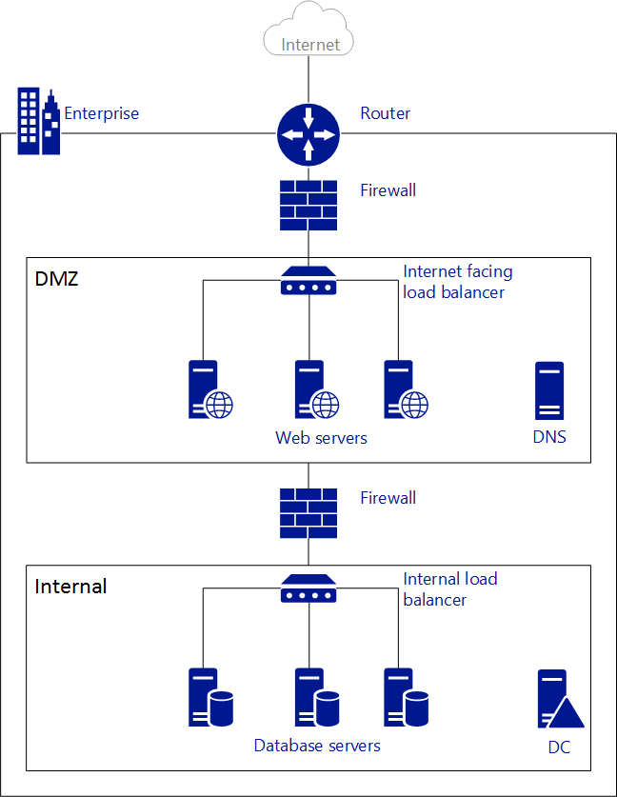
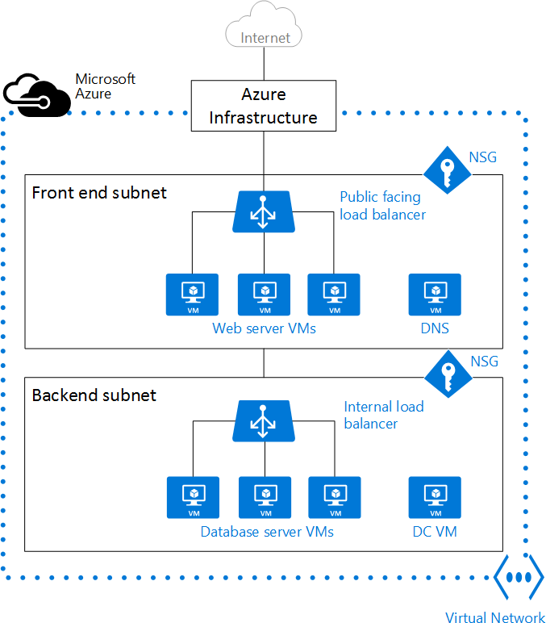
On –Premises Network Vs Azure VNET

Slide 30
Microsoft Azure Web Apps

Slide 31
Microsoft Azure Web Apps
Login to : https://portal.azure.com
Azure Web Apps
- simple scalable web sites in Azure ,is a low friction PaaS offering to host your web application.
- develop and deploy using Microsoft visual Studio with many programming languages ( .Net, JAVA, PHP, Node.js and python)
- Other tool – Git , Kudo
Configure Advance – Always On , custom domain and Auto scale using portal.
Think – Solving Business Problems
Flexibility , Scalability
Web App Tier
Free, Shared , Basic and standard
App Service Plan
Logically group Web Apps within a subscription.
Used to assign a tier to a group of Web App Instances capacity can be shared among them.
Associated with a pricing tier.
Auto scale Web Apps – Scale Out
means increasing the number of instances of the application
On and Off Workloads – e.g Batch jobs
Growing Fast
Unpredictable bursting – Unexpected / Unplanned peak in demand, sudden spik impacts application performance .
Predictable bursting – Services with micro seasonality trends,.

Slide 32
Configuring and publish an Azure Web Apps
Login to : https://portal.azure.com
Manage Application setting
Contoso Events Demo
Creating an ASP.NET Web App Using Azure Web Apps

Slide 33
Microsoft Azure SQL Database

Slide 34
Azure SQL Database Overview
Azure provides a database as a cloud service offering that allows developers to use SQL in the same way as they would in an on-premises location .
Manage SQL database instances using SQL Server Management Studio and Visual Studio tools .
SQL database as a Service ( DaaS ) Vs SQL Server in an Azure VM
Maximum database size – 500 GB
Fully managed database solution and also highly compatible with existing tools.
Managed - Azure Portal , Power Shell and CLI
Tier
Basic, Standard and Premium .
Other ‘s
DTU – database throughput Unit – measure performance level .

Slide 35
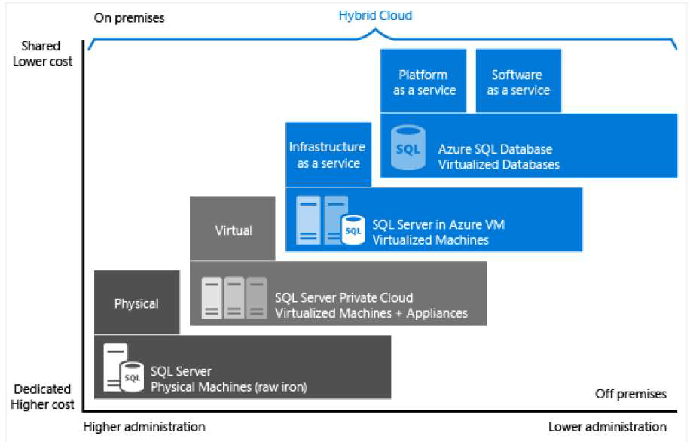
SQL database On-Off Premises

Slide 36
RBAC Access Control
What is RBAC
Allows secure access with granular permissions to resources
Assignable to users, groups or service principals
Built-in roles make it easy to get started
Role Definitions
Describes the set of permissions (e.g. read actions)
Can be used in multiple assignments
Role Assignments
Associate role definitions with an identity (e.g. user/group) at a scope (e.g. resource group)
Always inherited – subscription assignments apply to all resources

Slide 37
Azure SQL Demo
Login to : https://portal.azure.com
SQL database Portal demo.

Slide 38
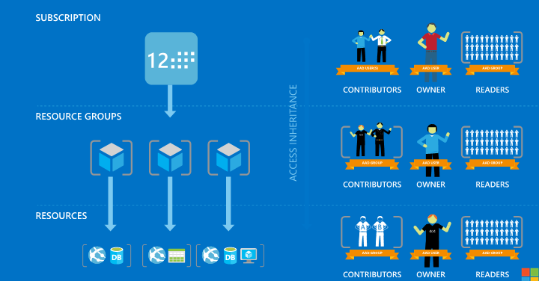
Role Based Access Control

Slide 39
Migrating Applications to Azure

Slide 40










When replicating workloads into Azure, execute tests to ensure readiness
Move a single application or an entire datacenter to the cloud with minimal impact to production users

Slide 41




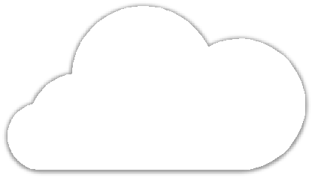









Azure Site Recovery
https://azure.microsoft.com/en-us/documentation/articles/site-recovery-support-matrix/

Slide 42
Designing a cloud Applications

Slide 43
Designing a cloud Applications
Concepts
Partitioning a workload
-when designing a web applications, split your business process into partitioning workloads i.e websits , cloud services and vm ; Ability to scale the different components of your applications.
Load balancing and strategy
Application Insight
Is a analytics and monitoring service for your applications.
- can be used with .NET or Java
Login to : https://portal.azure.com
Portal demo.

Slide 44
Securing Azure Web Application

Slide 45
Azure Active Directory
Managed identity and access management solution in Azure .
Focus on managing your domain , users and applications . Rich Single Sign On
Azure provides self service portals .
As a Identity provider that can provide identity and access functionality for your custom or SaaS applications.
Provide a suite of services that can integrate with custom applications , on-premise , existing domains and third party services.
Azure AD services
Directory services
MFA provider
Login to : https://portal.azure.com
Portal demo.

Slide 46
Azure Multifactor Authentication
Azure Multi-Factor Authentication (MFA) is Microsoft's two-step verification solution.
Two-step verification is a method of authentication that requires more than one verification method and adds a critical second layer of security to user sign-ins and transactions.
Azure Multi-Factor Authentication is an easy to use, scalable, and reliable solution that provides a second method of authentication to protect your users.
Verification methods:
Something you know (typically a password)
Something you have (a trusted device that is not easily duplicated, like a phone)
Something you are (biometrics)

Slide 47
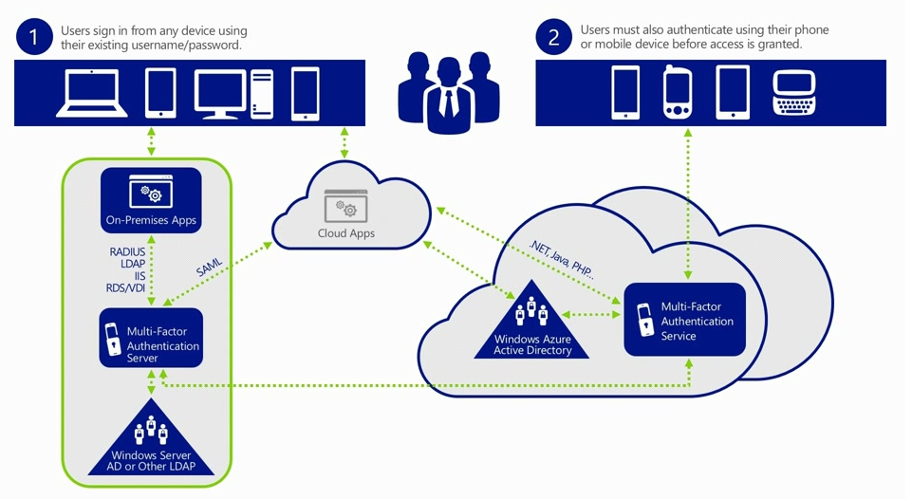
Azure Multifactor Authentication

Slide 48
Thank you

Slide 49
Referrences
https://docs.microsoft.com

